Slide 1
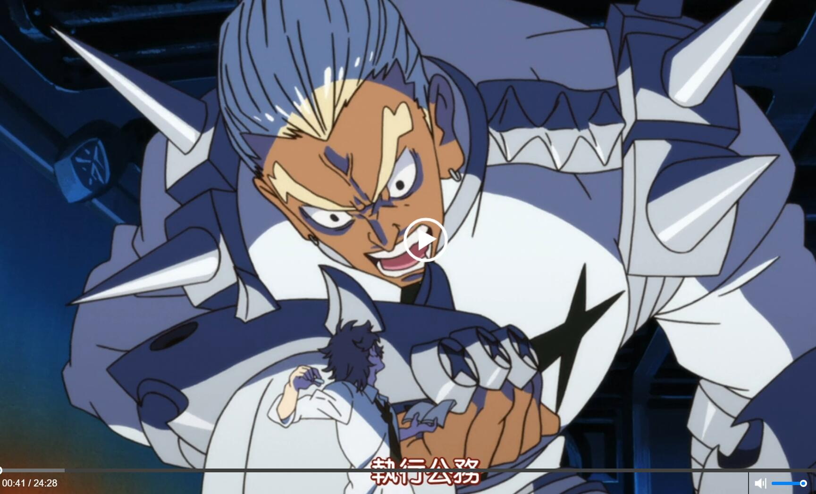
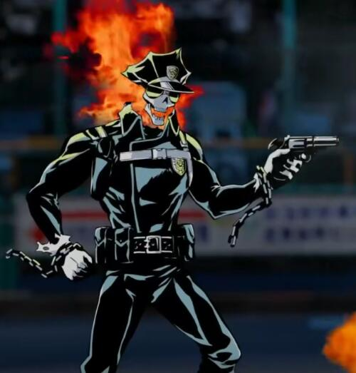
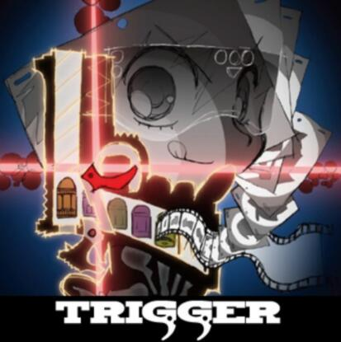
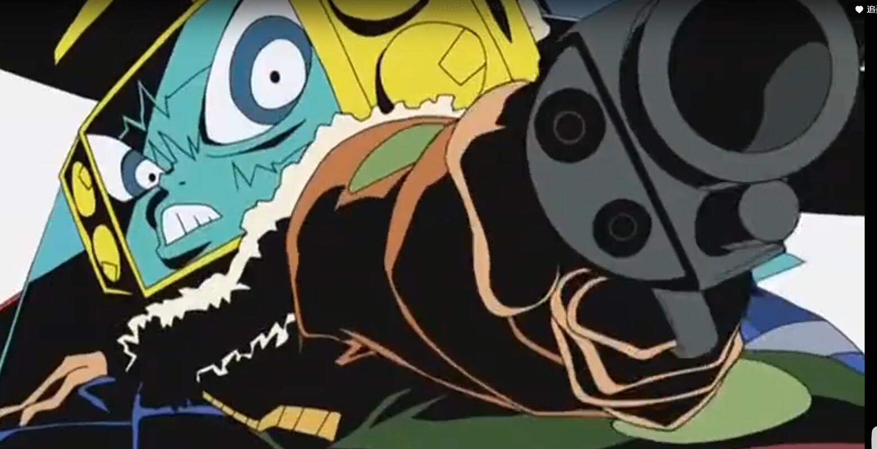
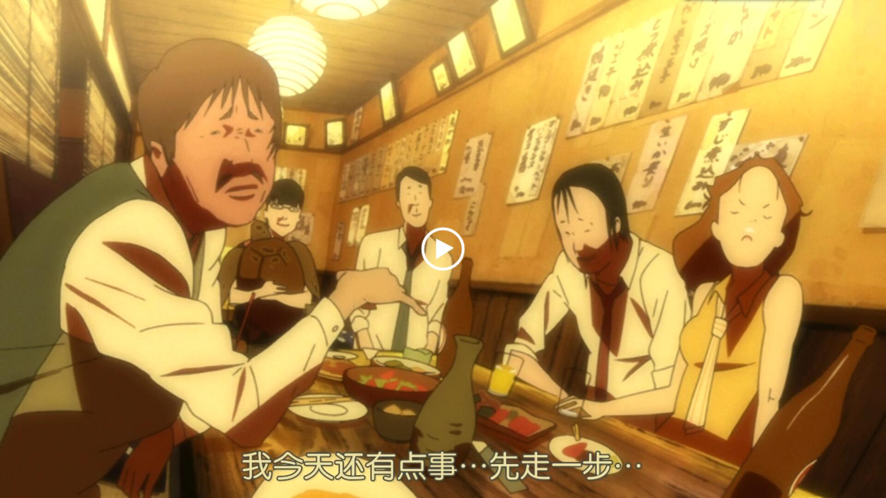
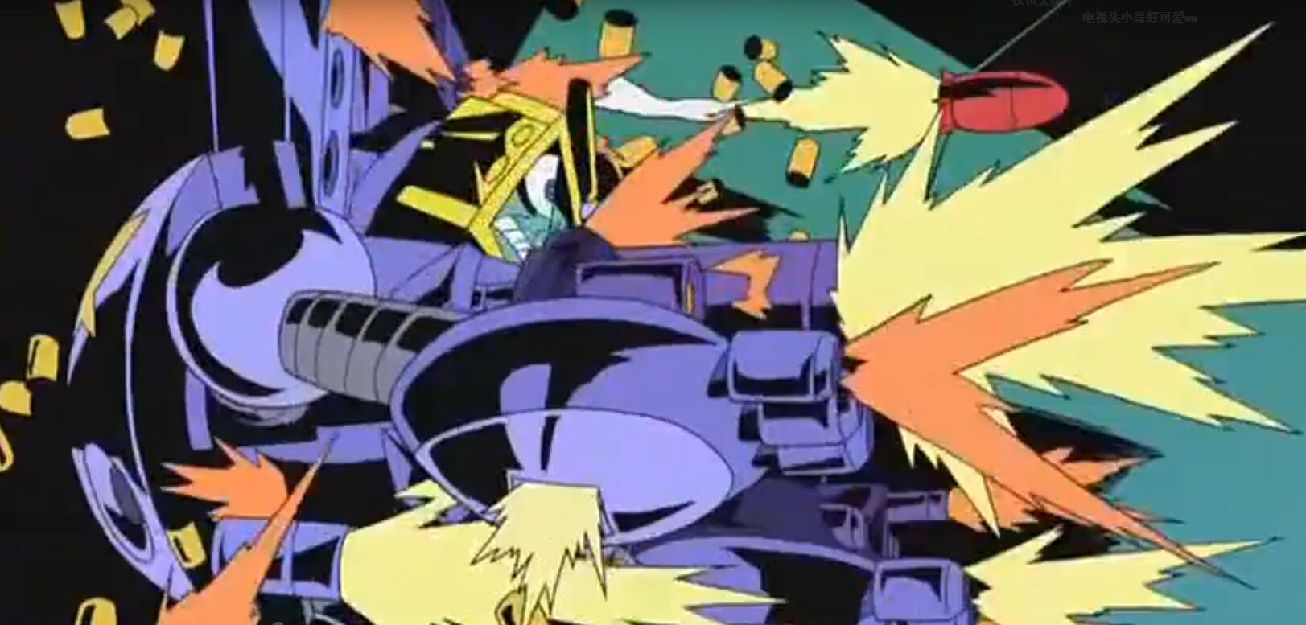
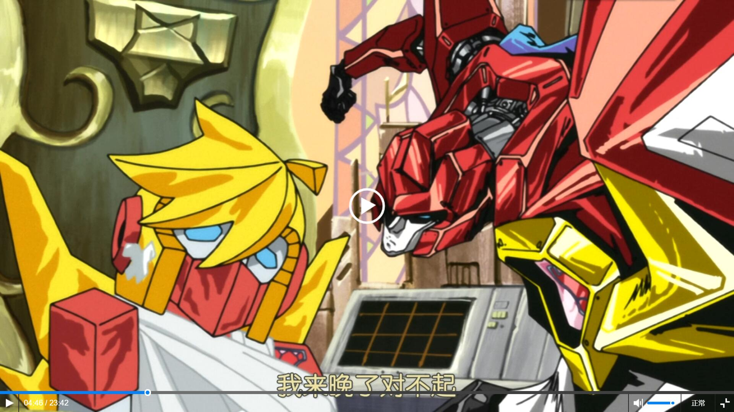
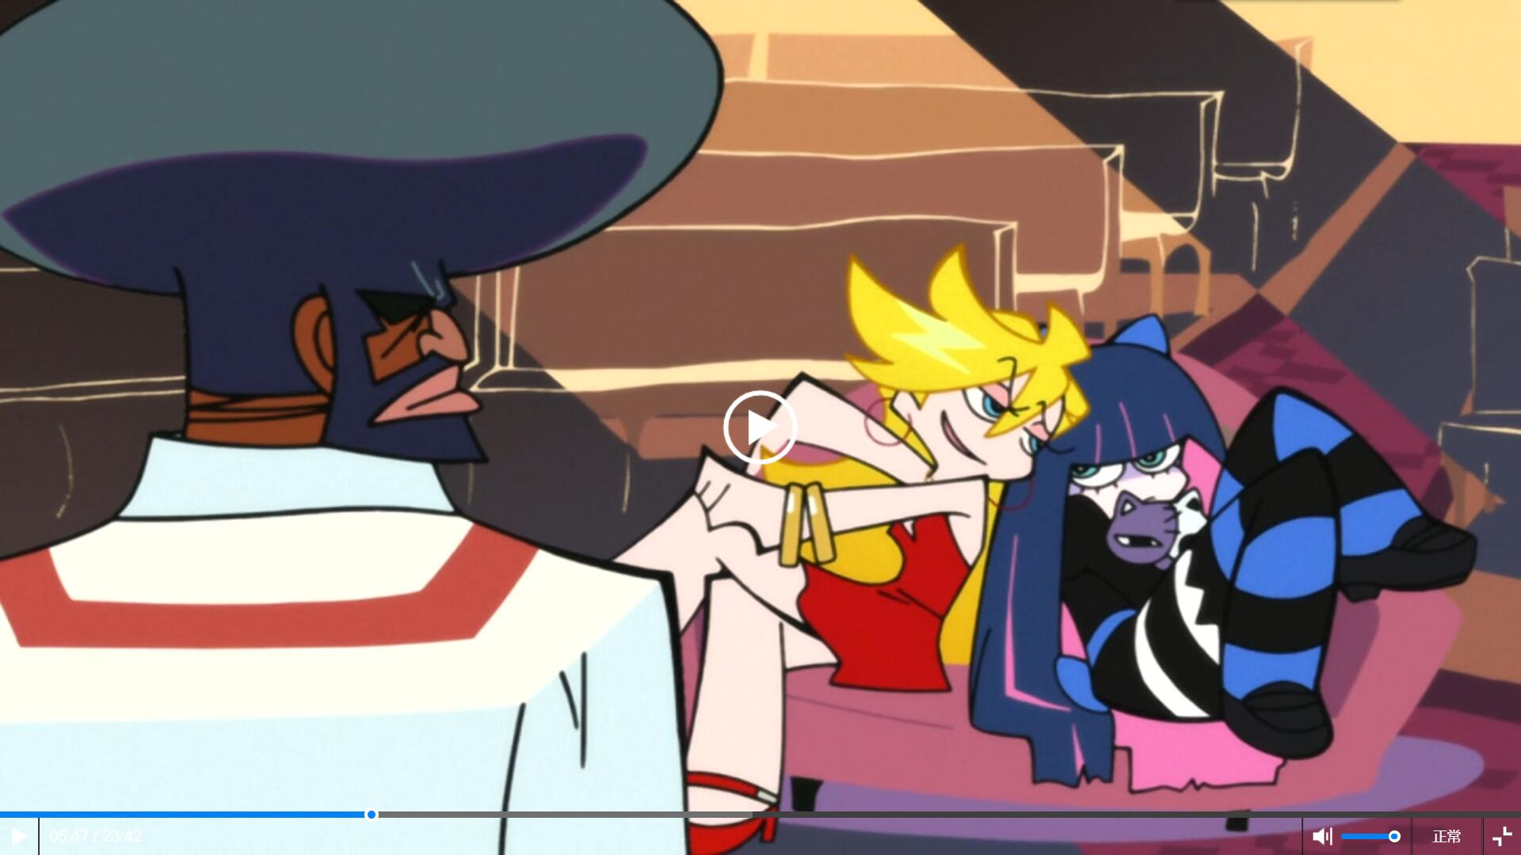
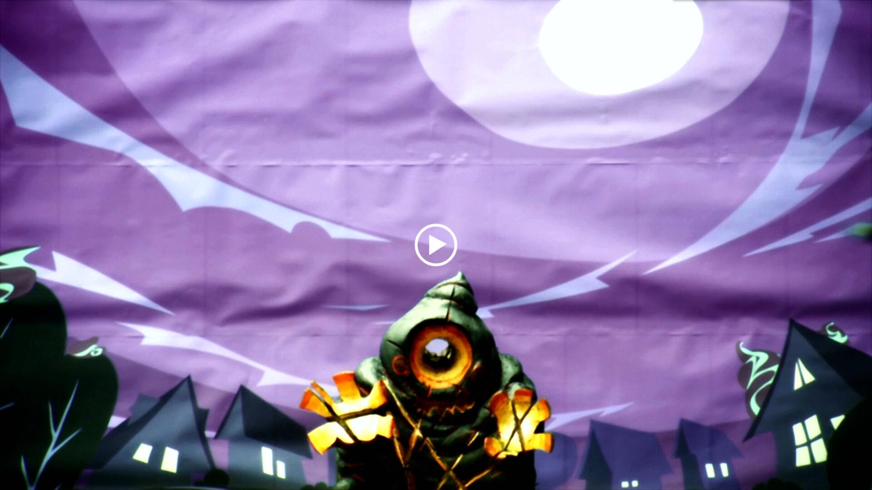
TRIGGER
Linqi Wang

Slide 2
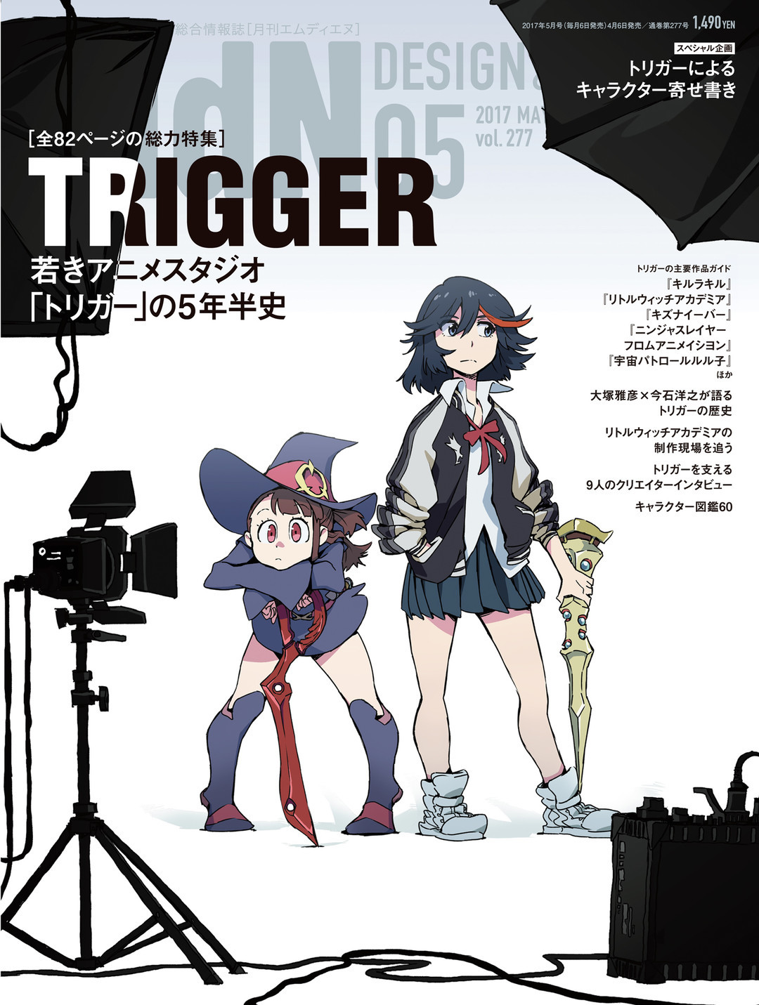
History
Style
Technology

Slide 3
History

Slide 4
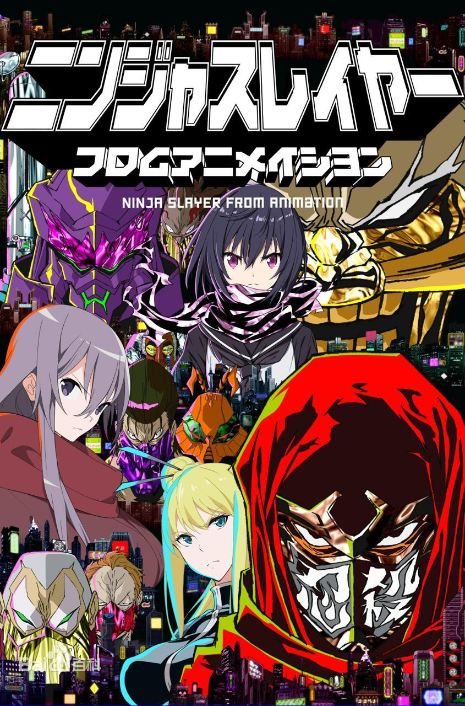
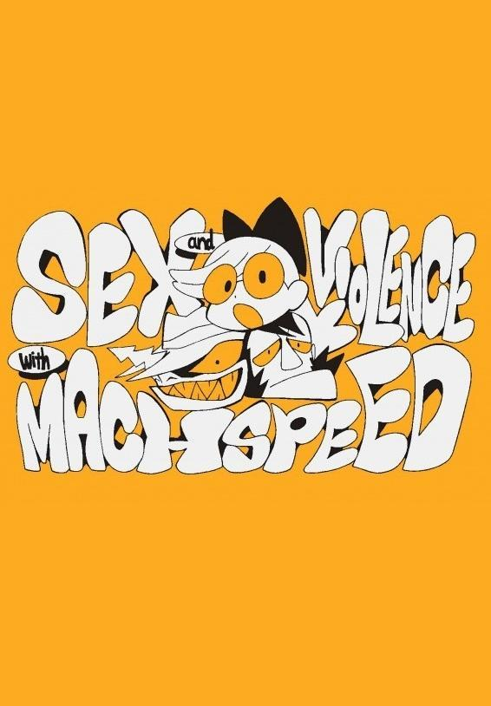
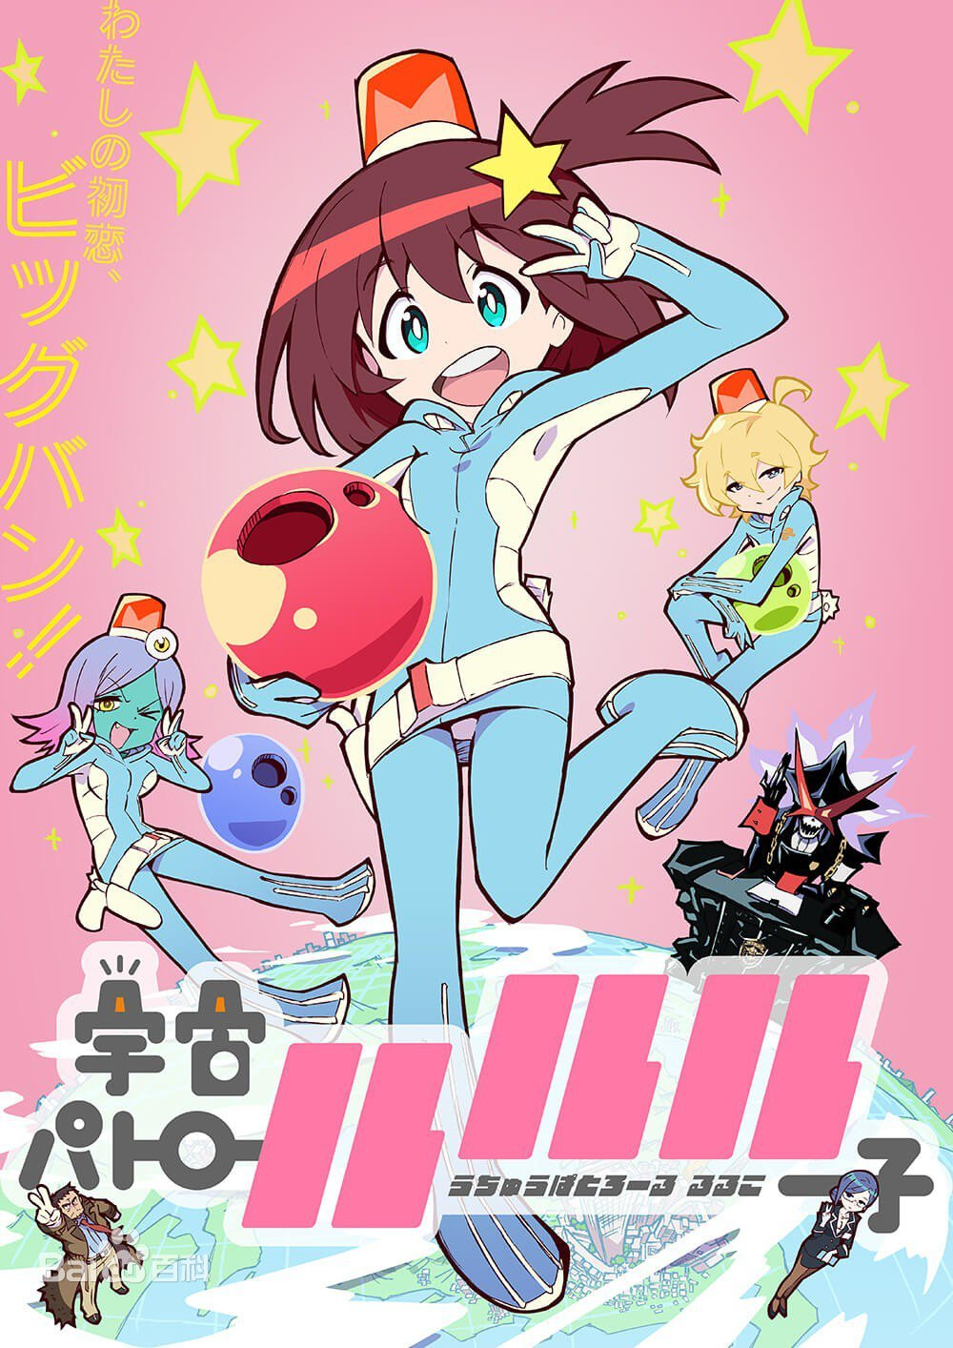
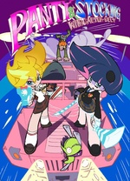
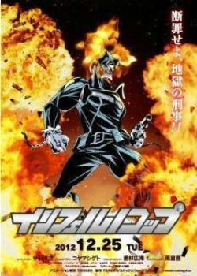
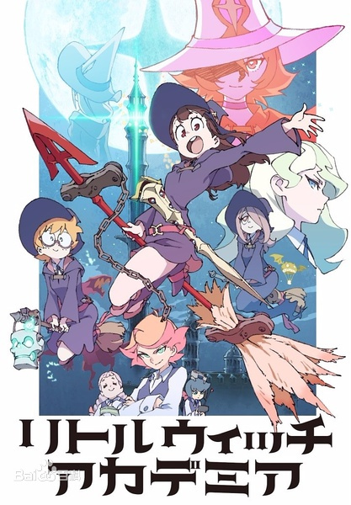
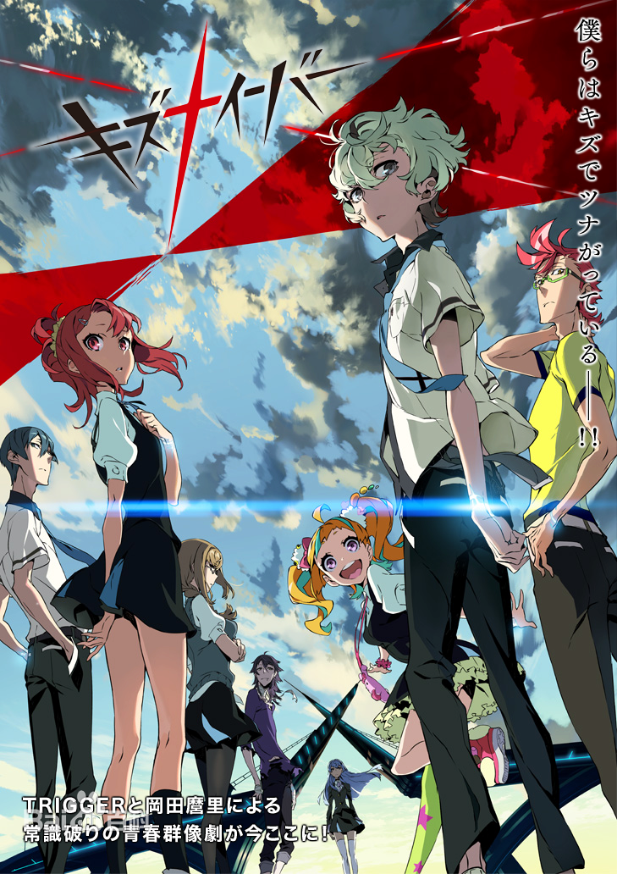
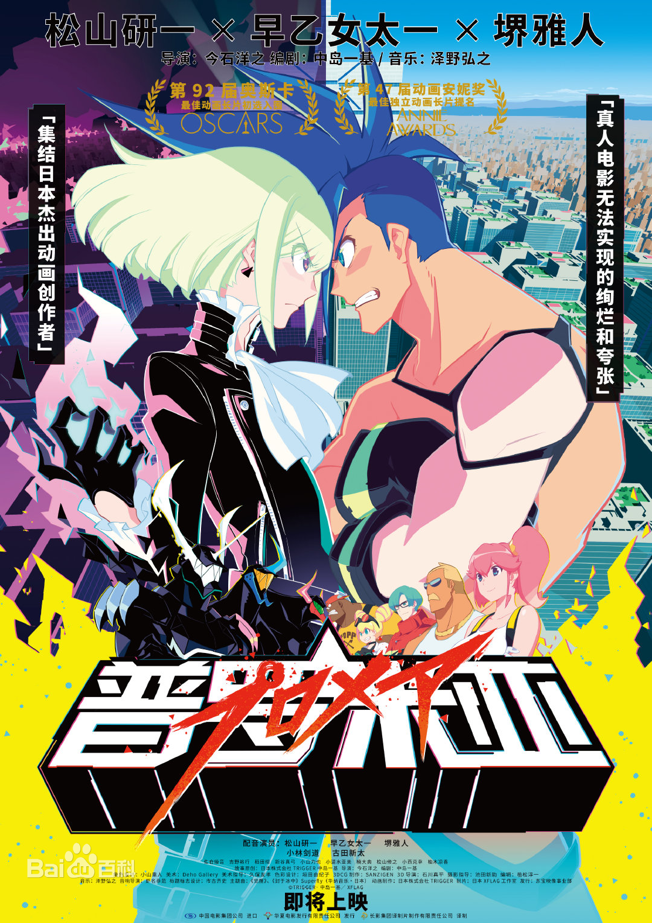
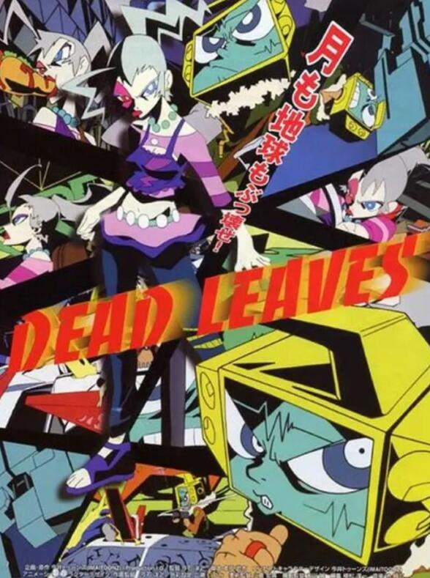
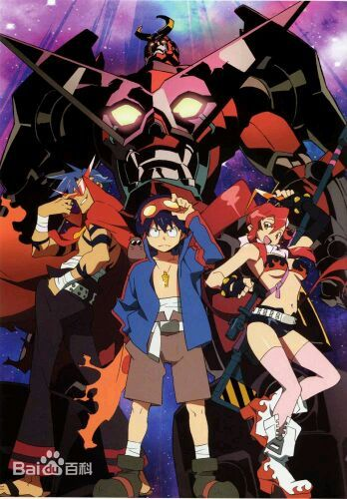
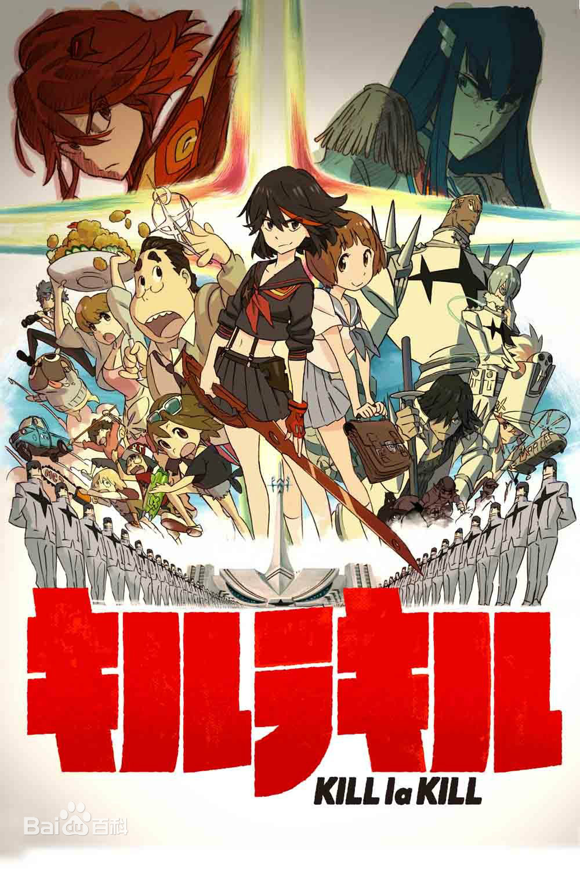
2007
Tengen Toppa Gurren-Lagann
2011.8
TRIGGER was set up by core members of GAINAX
2017
Little Witch Academia
TV
2013
Kill
La
Kill
2014
2004
Dead leaves
2010
Panty & Stocking with Garterbelt
2012
Inferno Cop
2015
Little Witch Academia
Animation
Film
Sex& Violence
With
Machspeed
NINJA SLAYER FROM ANIMATION
2016 Kiznaiver
Uchuu Patrol Luluco
2019
PROMARE

Slide 5
Style

Slide 6
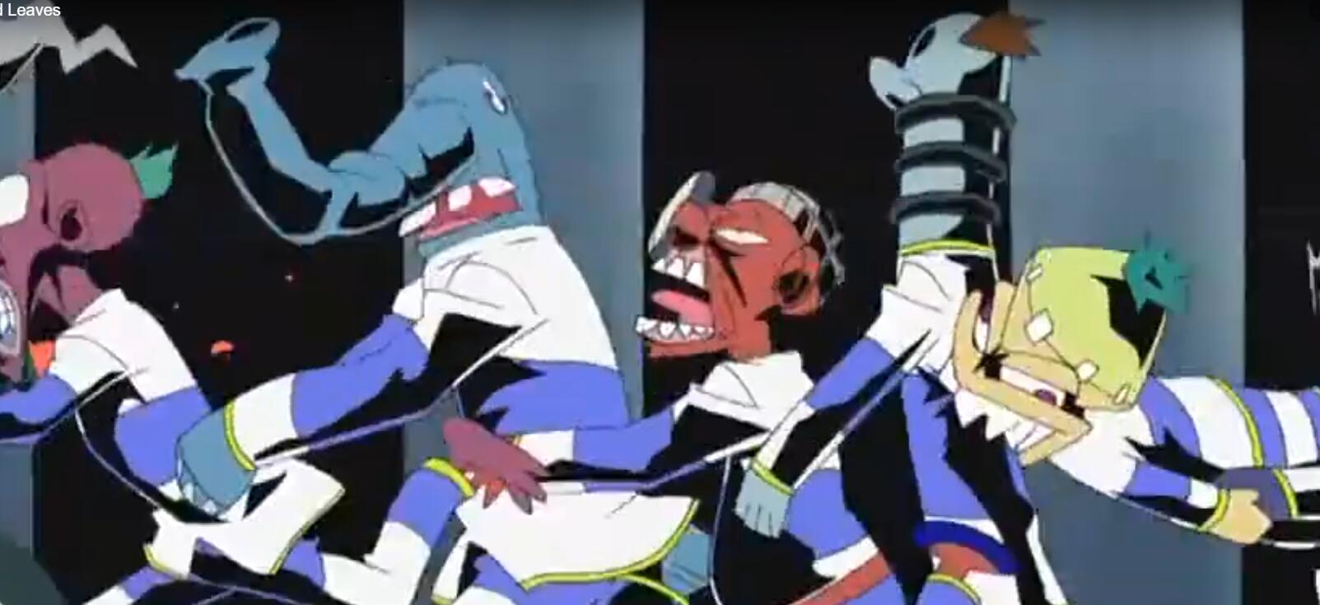
Dead Leaves
As the first animation of him, he was completely not considered about the market and audience, only followed his imagination. This kind of crazy animation laying the groundwork of TRIGGER’s style.
The story is about a TV man and a pregnant woman lead prisoners to escape prison.

Slide 7
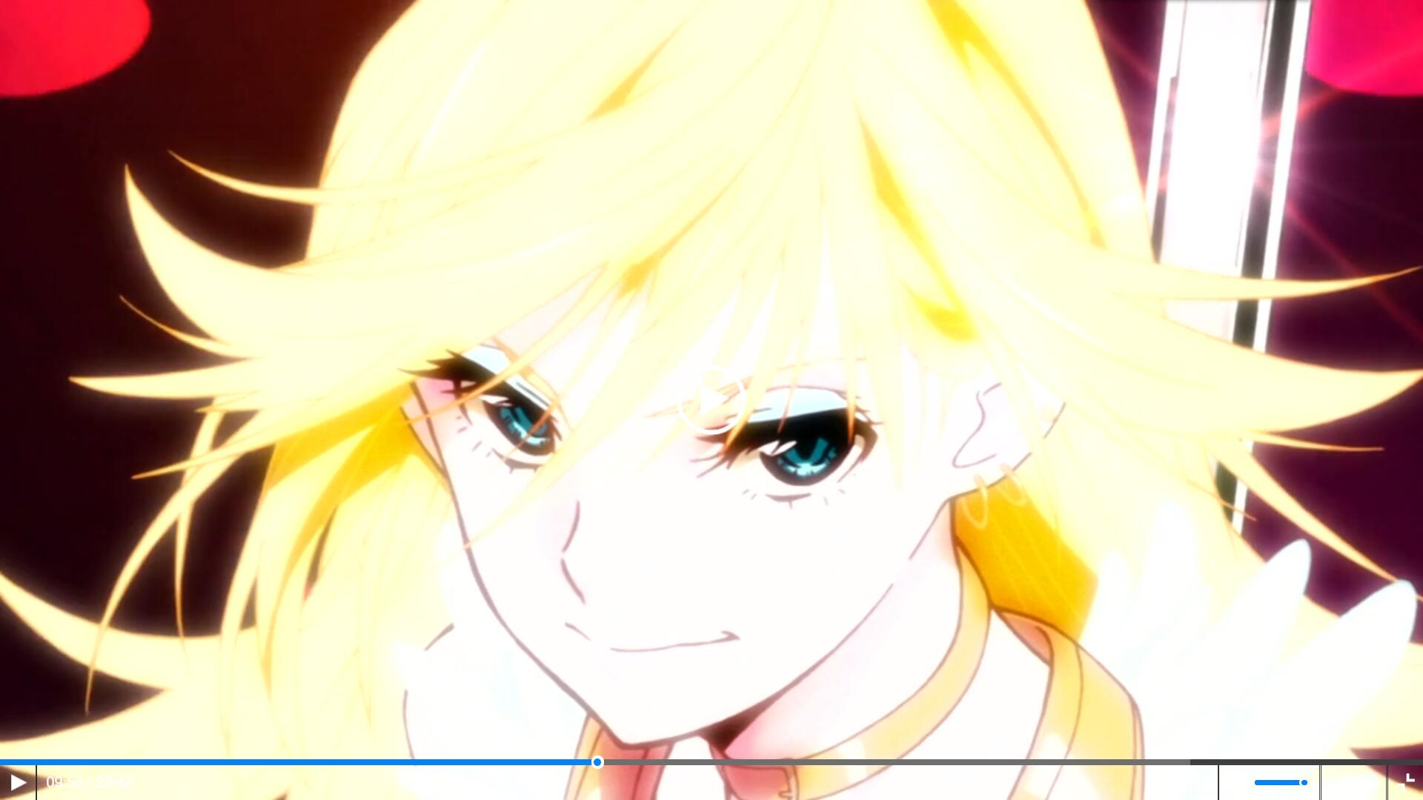
Panty & Stocking with Garterbelt
This animation has not only one style, and the main style is quite similar with American animation, this is quite special as a Japanese animation.

Slide 8
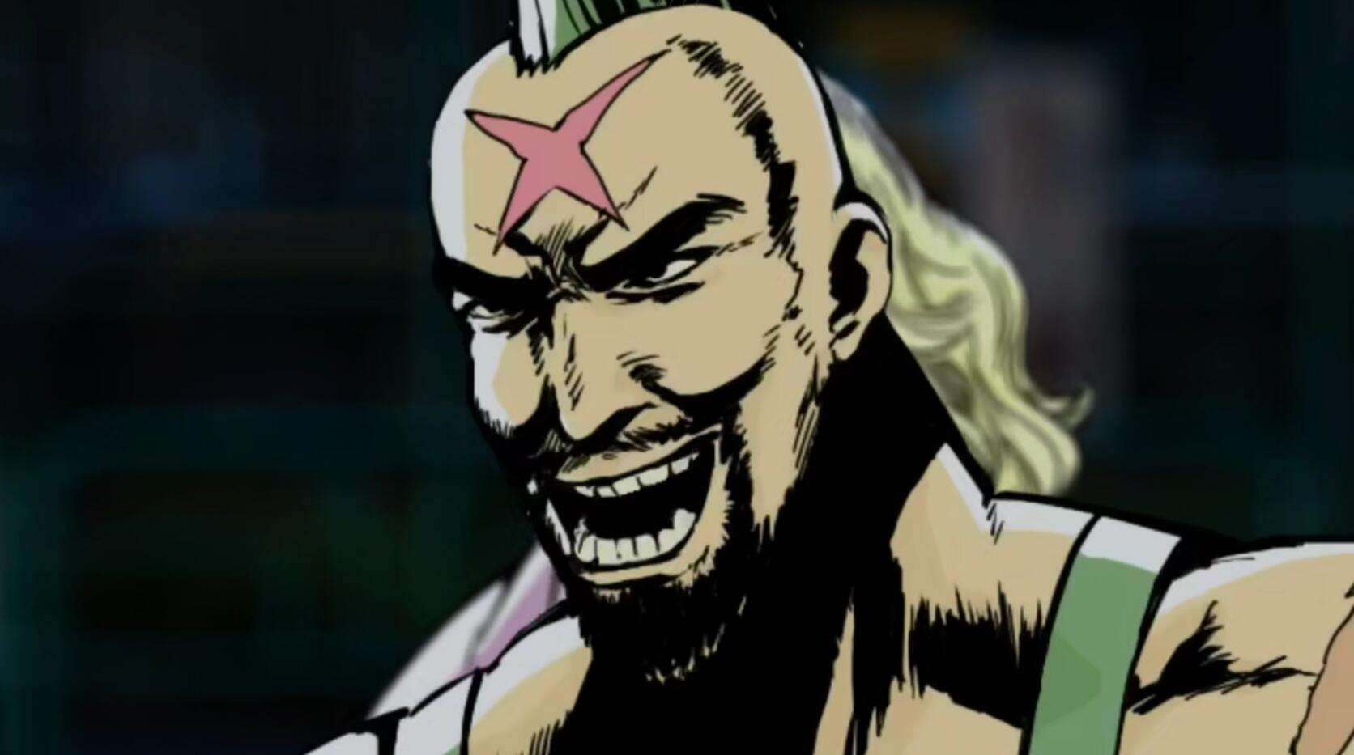
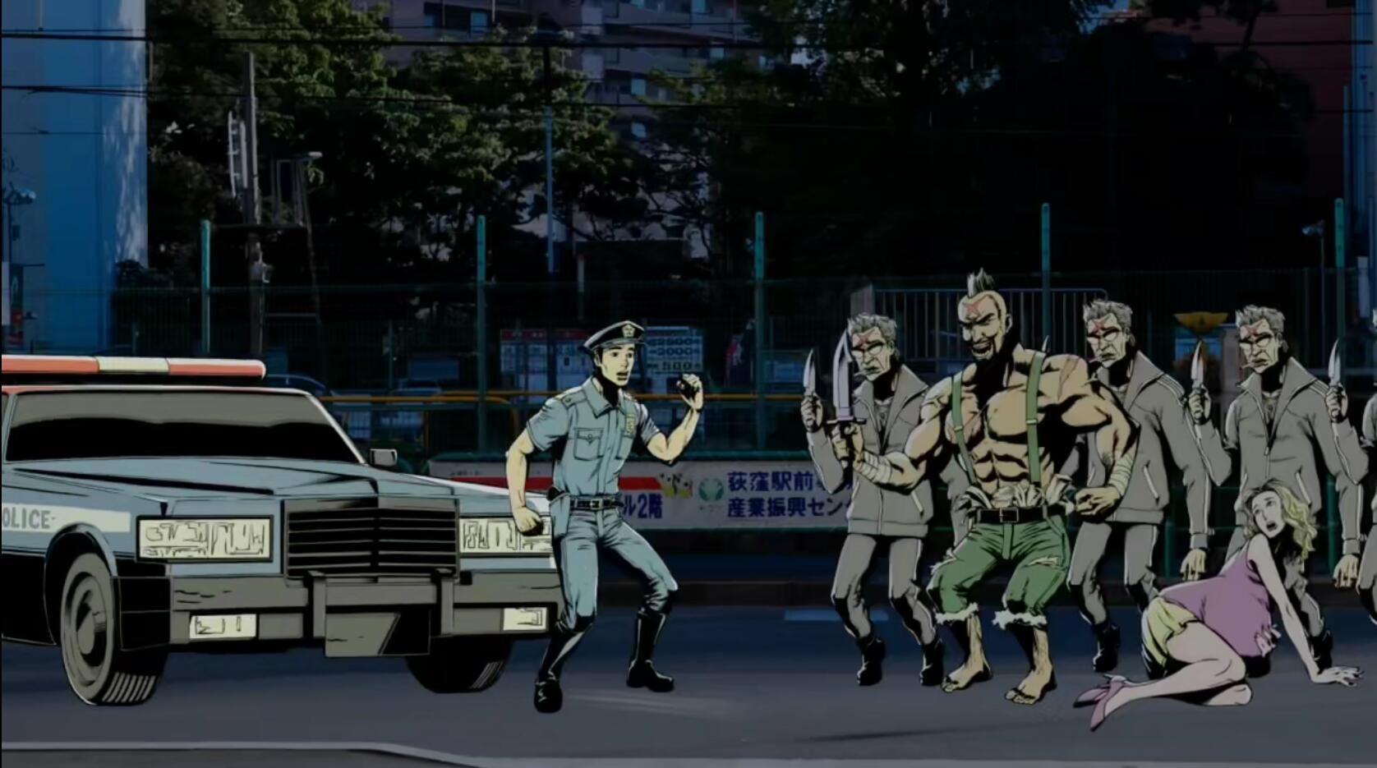
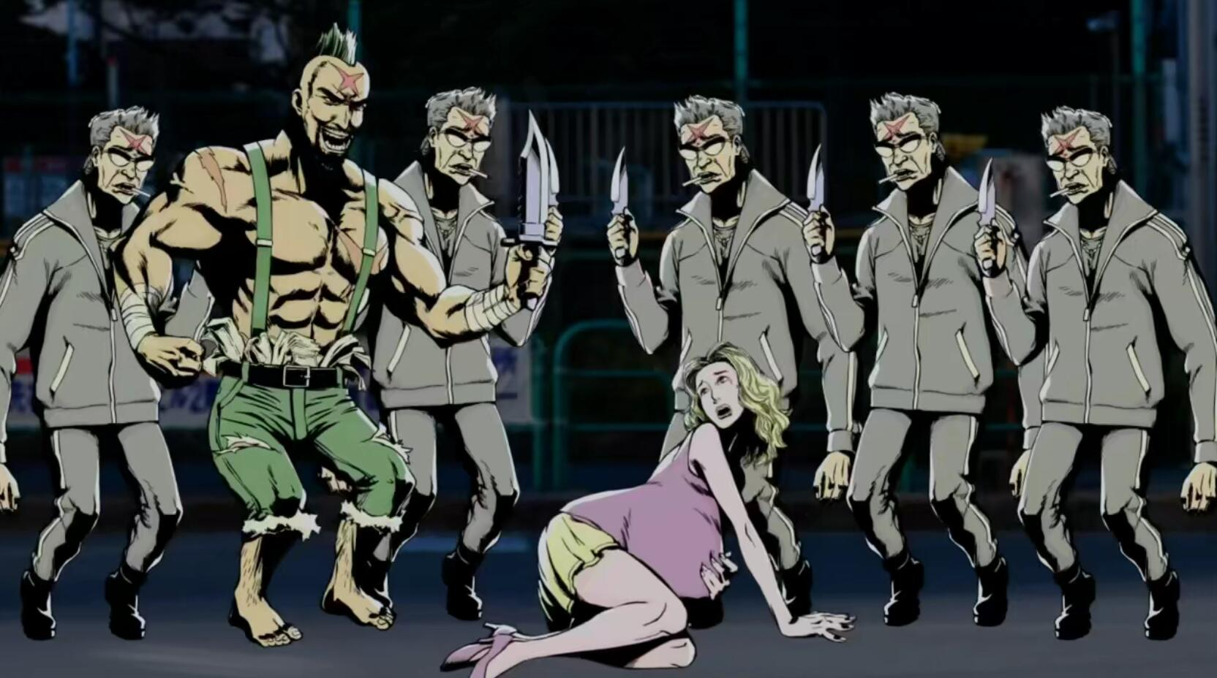
Inferno Cop
Because they were lack of money as a new animation studio, they made this experimental “PowerPoint” animation at that moment, but not very famous.

Slide 9
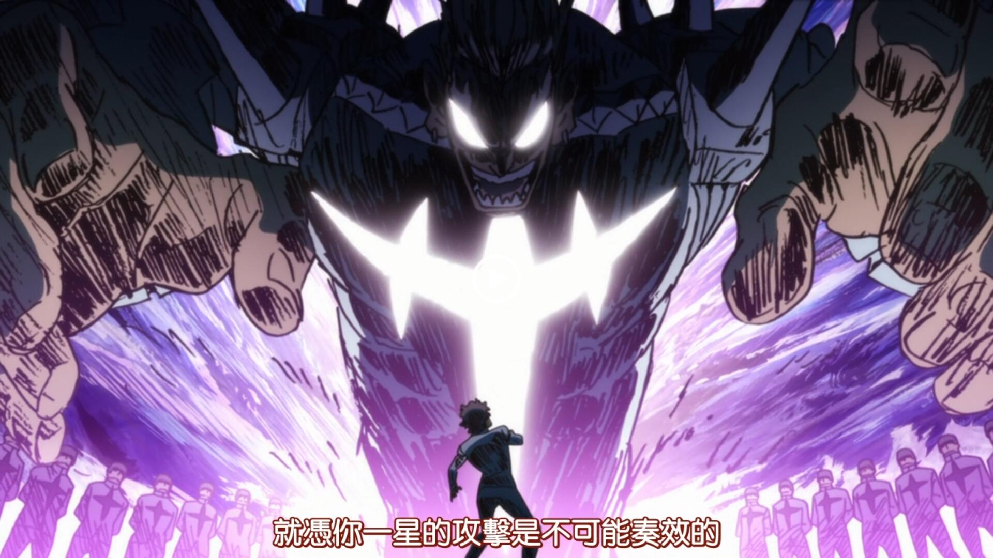
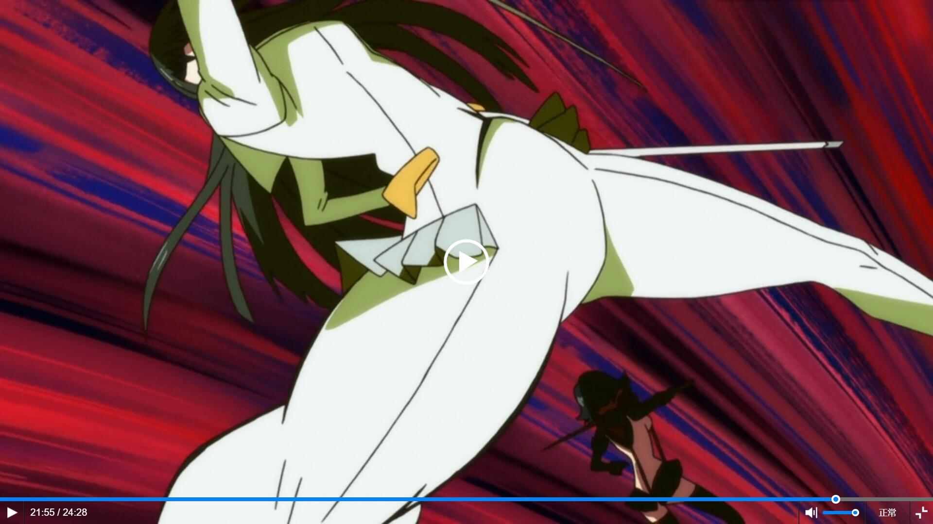
Kill La Kill
2013, TRIGGER made their first animation. Since this animation, TRIGGER ensured their main style of their work. After this animation, most of their style of other original animation are similar with Kill La Kill.

Slide 10
Technology

Slide 11
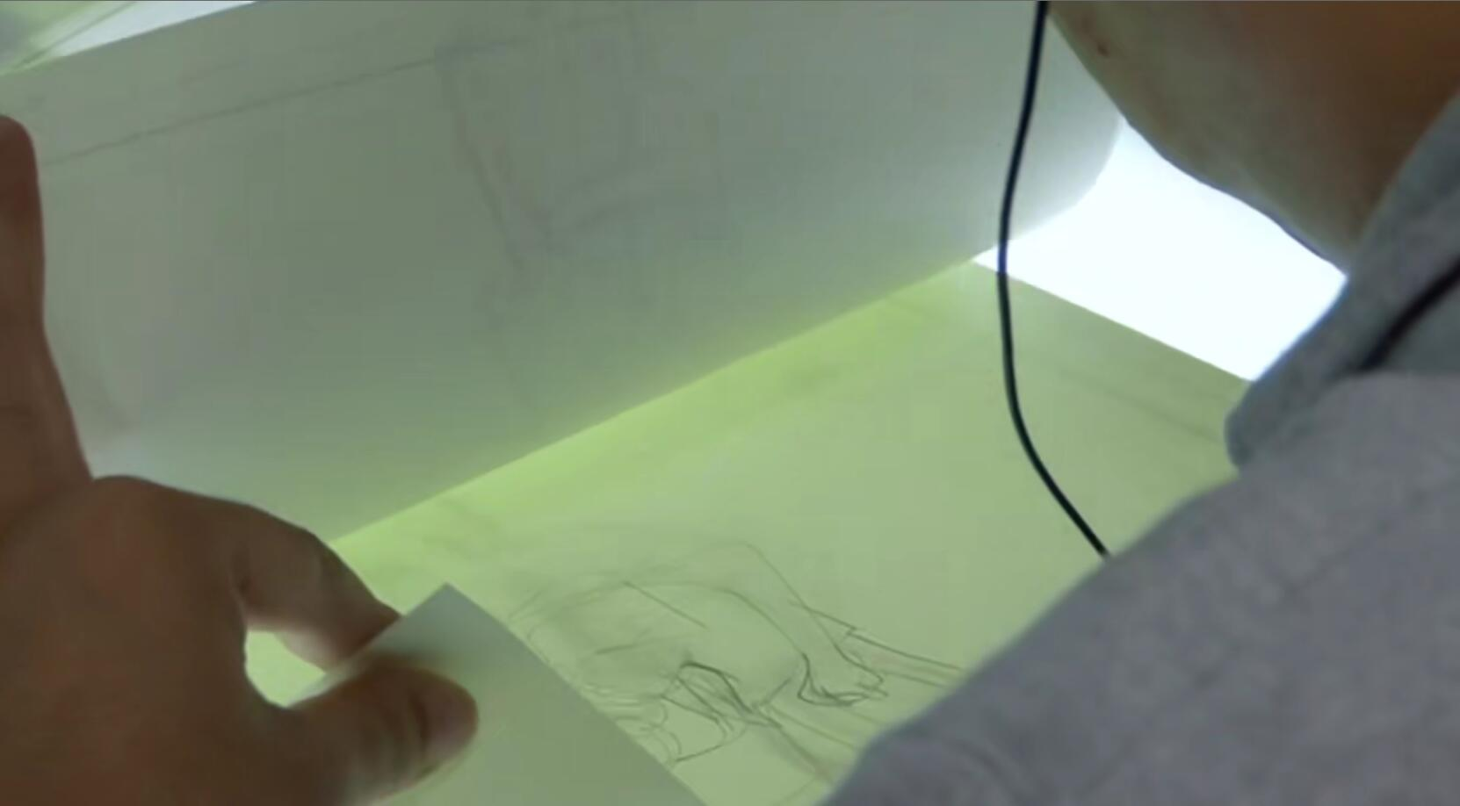
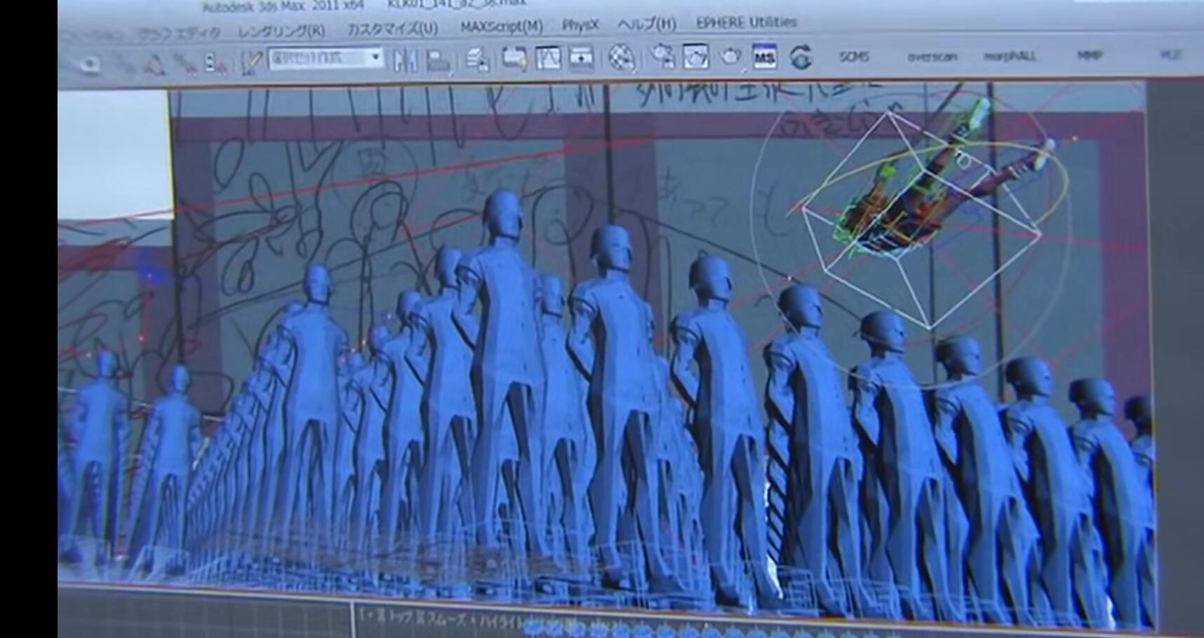
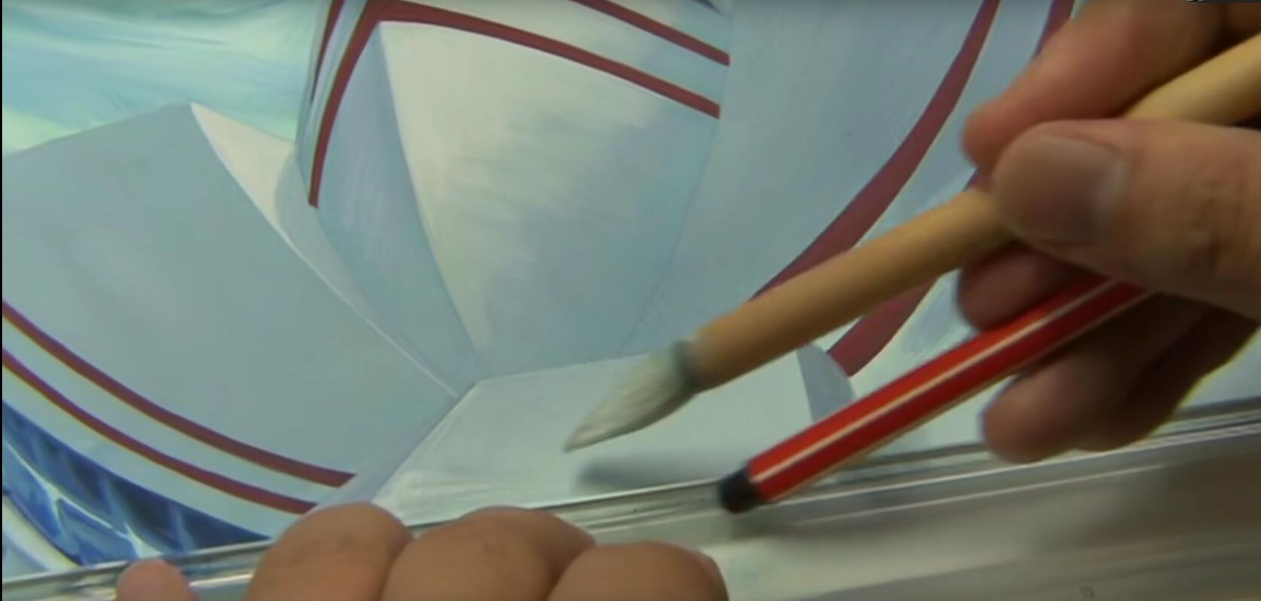
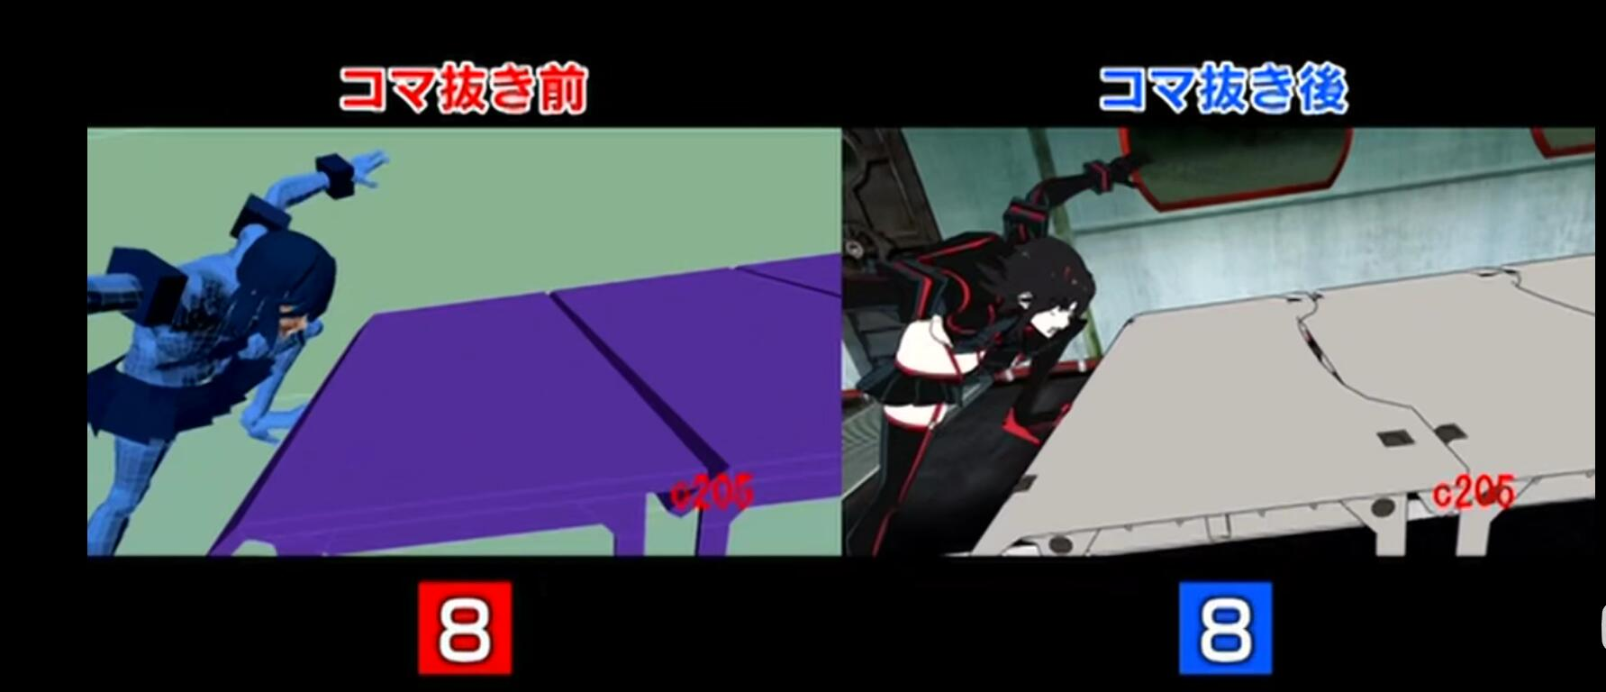
Similar with other Japanese animation studios, they also use 2D hand-drawing as main and 3D as support.

Slide 12
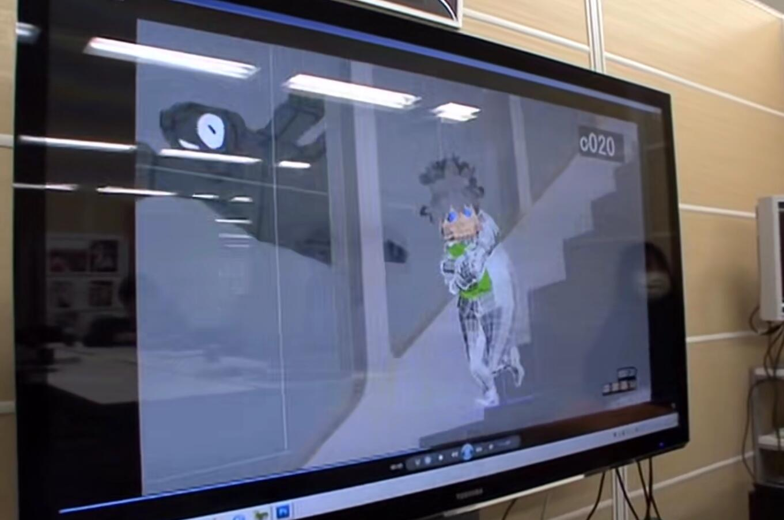
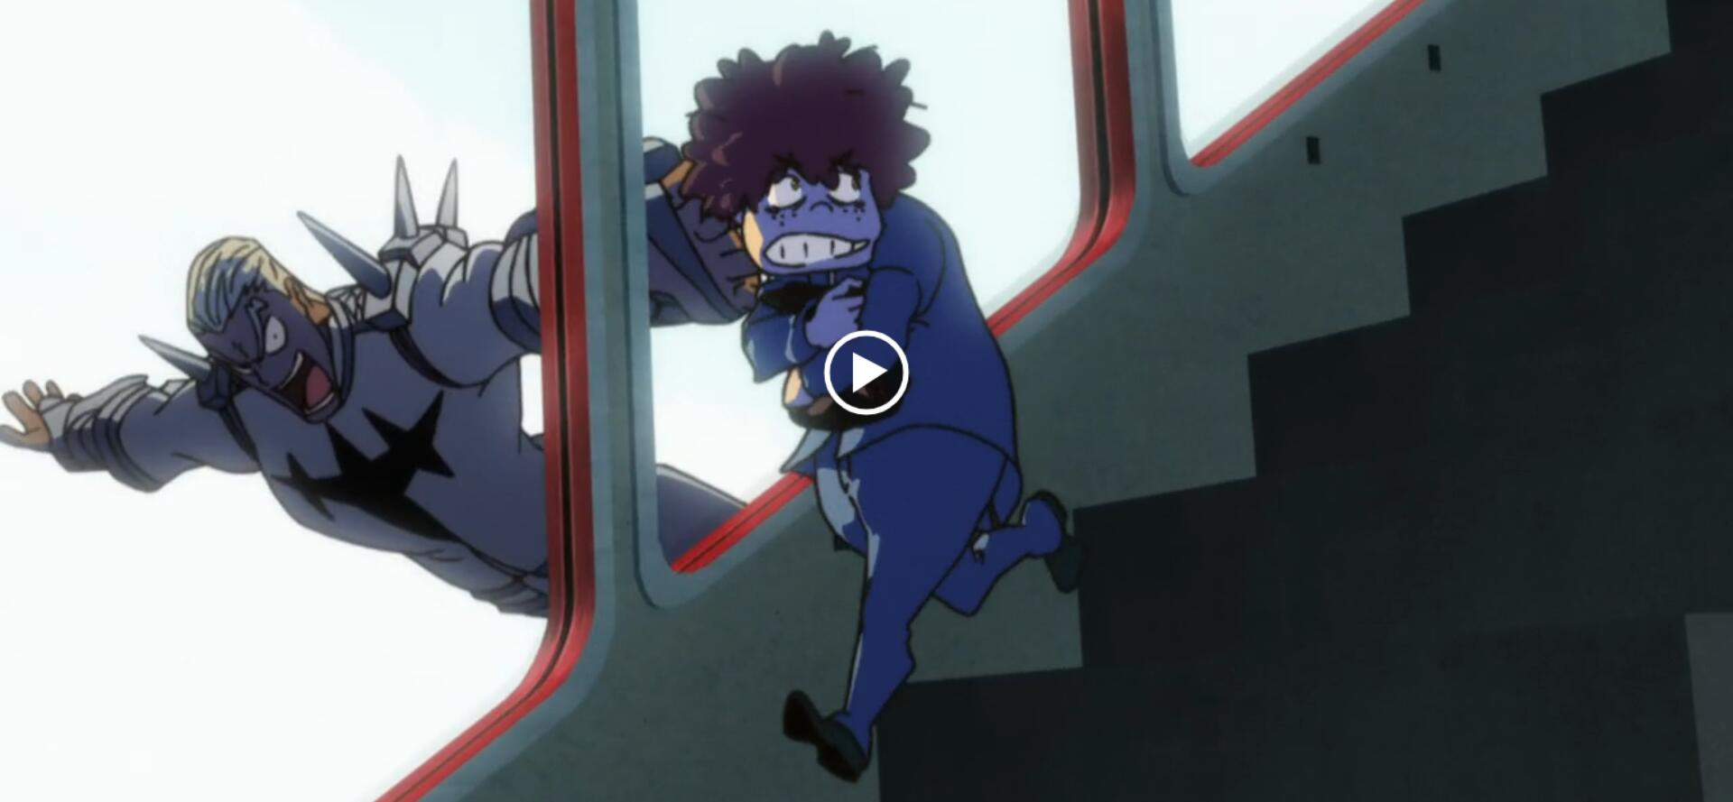
For example they used 3D technology at this part only because their 2D hand-drawing animators can’t draw these movements.
On the other hand, they reduced some unnecessary frames to make these 3D animation not very smooth and connect with 2D better.

Slide 13
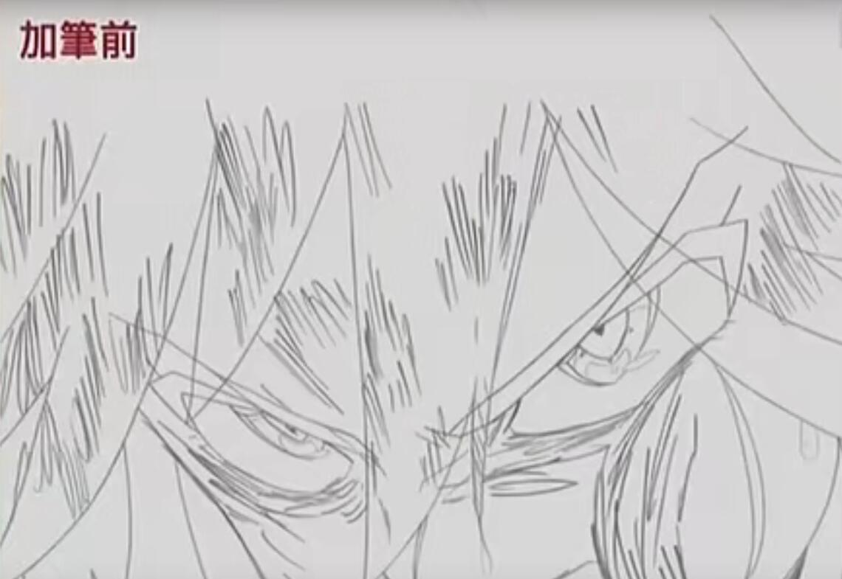
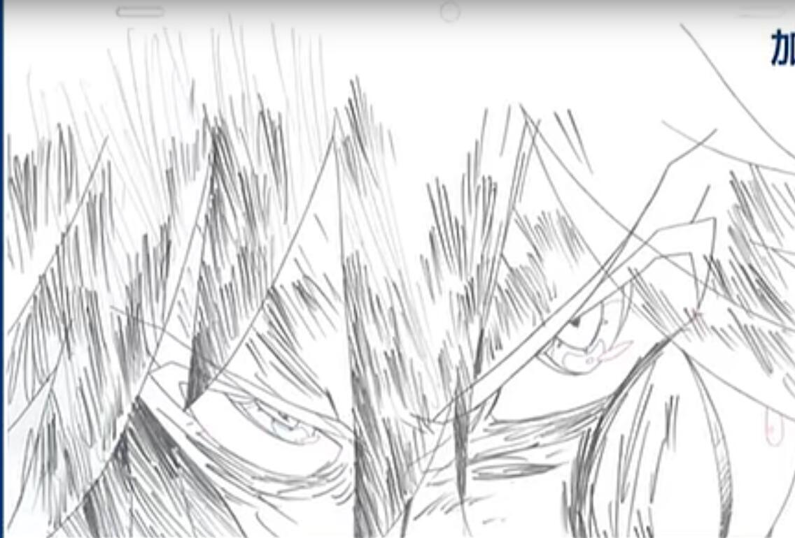
In 2D part, they will use some kind of method to express character’s emotion.
For example at this part, the animator added some coarse black line to make the image dirtier to express character’s anger.

